Slide 1
Neurofeedback-Linked Suppression of Cortical β Bursts Speeds Up Movement Initiation in Healthy Motor Control: A Double-Blind Sham-Controlled Study
Shenghong He, Claudia Everest-Phillips, Andrew Clouter,
Peter Brown, and Huiling Tan
The Journal of Neuroscience
May 13, 2020
Notes:
neurofeedback-behavior task paradigm -> specifically targeted high amplitude b bursts -> to train healthy subjects to self-suppress b bursts in the sensorimotor cortex

Slide 2
Introduction

Slide 3
Parkinson’s Disease
Cardinal signals:
Bradykinesia
Rigidity
Tremor
Postural instability
→ Goal: find EEG features that are causally related to PD symptoms and can be trained via neurofeedback
(Mehler, 2022)
Notes:
Other motor symptoms:
- balance problems
- Micrographia (abnormally small, cramped handwriting)
- slow movement initiation
-> focus of this study

Slide 4
Features (previous studies)
β band oscillations are modulated by movements and motor imagery
↓ β power → ↓ RT (macaque monkeys)
temporal dynamics of the β band oscillations: β bursts
later β bursts → ↑ RT
↑ β burst rate → ↑ RT
↑ β amplitude → ↑ RT
Notes:
β bursts: transient events of high-amplitude β oscillations

Slide 5
Main contributions of this study
Are cortical β power or β burst characteristics a better predictor of RT?
Is NFT a potential tool for healthy participants and/or PD patients to speed up movement initiation by training the voluntary modulation of sensorimotor β bursts?
Notes:
Interested in whether…
Establish if…

Slide 6
Materials & Methods
Notes:
double-blind sham-controlled design with 20 healthy participants

Slide 7
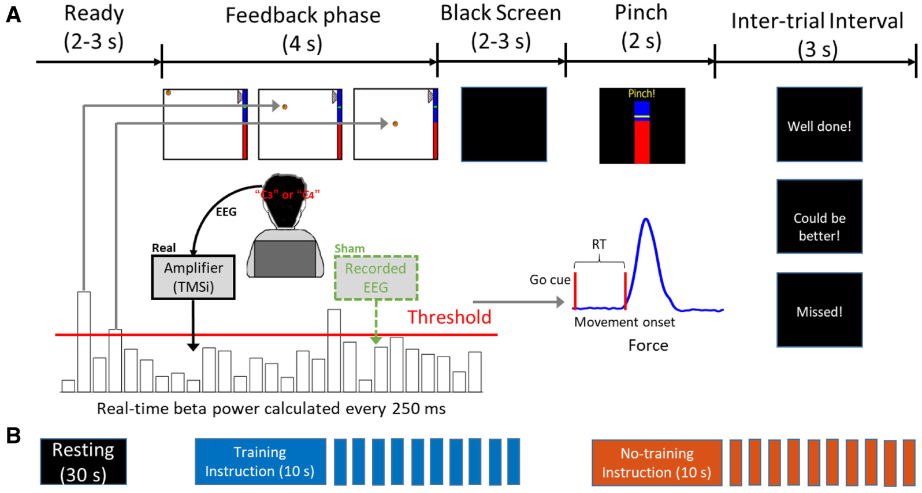
Trial
Notes:
Sequential neurofeedback-behaviour task
Pinch movement: instruction - as fast as possible, 50% of MVC

Slide 8
Calibration: initial
(1) hemisphere-specific frequency band (5 Hz width):
peak freq ± 2 Hz in the β band (13–30 Hz) with maximal movement-related power reduction
mean: ~19 Hz (range: 15 to 24 Hz)
Notes:
Freq band for feedback during the online experiment
during
30 trials of cued finger pinch movements

Slide 9
Calibration: each block
(1) hemisphere-specific frequency band (5 Hz)
(2) determine the threshold for burst detection:
during 30 s rest period
average β power over 500 ms windows (n=118)
75th percentile

Slide 10
Neurofeedback
Real feedback group:
real-time detection of β bursts (=average β power over the previous 500 ms window)
Sham feedback group:
calculation of β bursts based on resting EEG recorded from six healthy controls
→ ball drops upon detection of supra-threshold
β burst
Notes:
Basketball: moved left to right at constant speed
position updated every 250 ms
Real feedback group:
real-time detection of β bursts
calculation: average β power over the previous 500 ms window at C3 or C4
Sham feedback group:
similar calculation of β bursts
BUT: resting EEG recorded from six healthy controls was used
The main difference between the real feedback and sham feedback was whether the exact timing of the basketball movements matched with the presence of the b bursts.
Upon detection: ball drops
-> final ball position is dependent on number of detected bursts

Slide 11
Task
Notes:
Runs:
- 30s rest recording -> calibrate the threshold for burst detection
- 10s training or no-training instructions
- 10 trials
Training blocks:
- keep the ball floating at the top of the screen
-> find mental strategy to reduce beta bursts
- instructed that motor imagery might help
No training blocks:
- pay attention to the ball movement

Slide 12
Task
Trial
Run
3 days x 2 hemispheres x 4 runs x (1 training block + 1 no training block) x 10 trials
= 480 trials / subject
Notes:
3 days in 1 week

Slide 13
Outcome measures
Vertical cursor position → ∆ conditions, learning effect
Motor performance: RT → movement initiation
RT = tRTthreshold – tgoCue
EEG features:
average β power
β burst rate per second
accumulated β burst duration
Notes:
Final VCP:
- indicates the difference between the training and no training conditions
- allows to track the training progress over time
(ThresholdRT = mean + 3*SD of 500-ms force data before the go-cue)
EEG features were calculated during the neurofeedback and the preparation phase

Slide 14
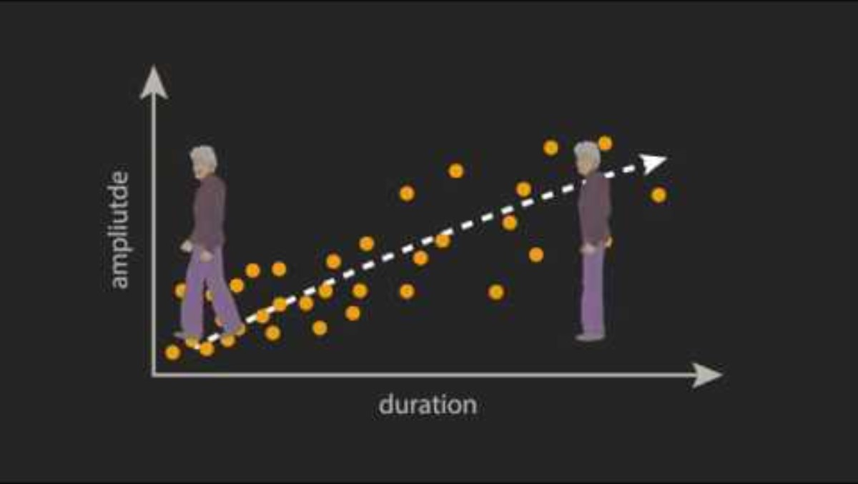
β power, β burst amplitude, duration, rate
(Tinkhauser et al., 2017)
Notes:
Beta activity is not constantly elevated – it fluctuates and comes in bursts

Slide 15
Results

Slide 16
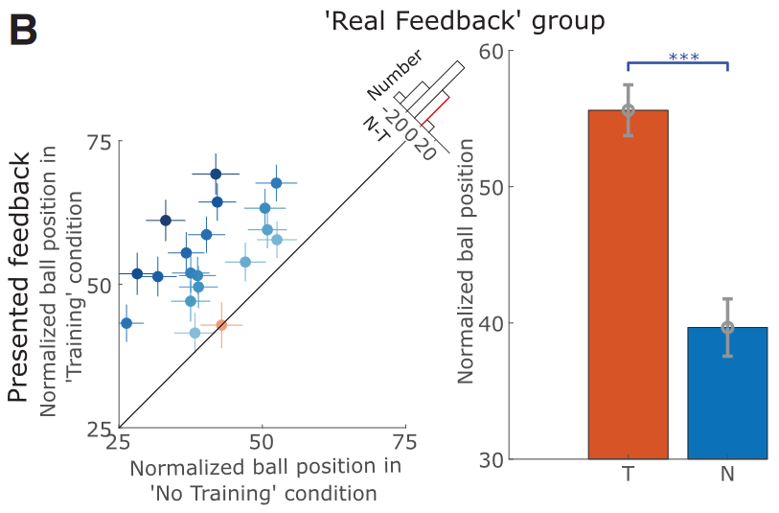
Participants were able to control β bursts
Notes:
The participants were able to control the position of the visual cursor driven by cortical b bursts
Left plot:
- Dots: individual averages of the measured hemispheres, crosses are the SEMs
- Shading of dots: difference between training and no training conditions
- histogram: also represents this difference between conditions and the number of cases
Bar plot (right):
- Group averages
Significant difference between training and no training conditions
‘Real feedback’ group could successfully control the vertical ball positions

Slide 17
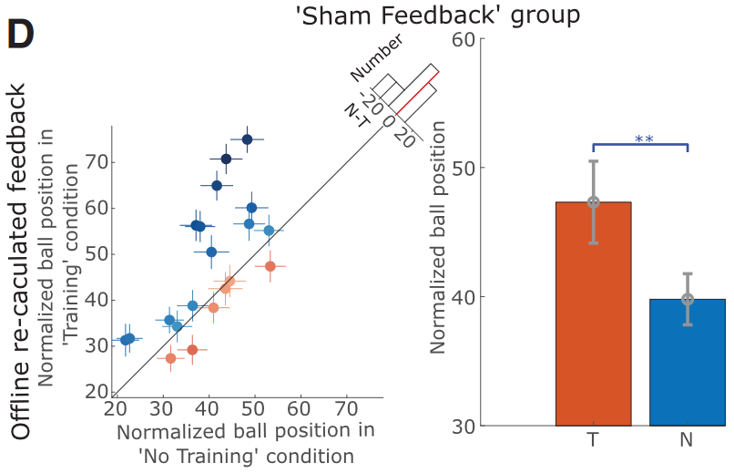
Participants were able to control β bursts
Notes:
‘Sham Feedback’ group for comparison:
They received feedback based on a pre-recorded EEG, but here they looked at what the ball position would have been if calculated from the “real” EEG.
The ball position is also significantly higher for the training condition
‘Sham feedback’ group also employed strategies that led to a reduction in beta bursts.
A subsequent ANOVA confirmed that the real feedback group outperformed the sham feedback group in suppressing beta bursts.

Slide 18
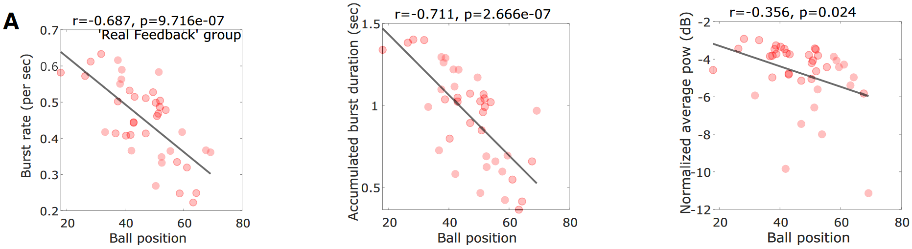
NFT led to reduced β bursts
Significant reduction:
- training compared to no training condition
- only in real but not in sham feedback group
Notes:
‘Real feedback’ group:
the ball’s final vertical position (x-axis) negatively correlated with ….
- the rate of beta bursts
- accumulated burst duration
- average beta power (WEAK correlation)
during the neurofeedback phase
ANOVA…

Slide 19
NFT reduced RTs in subsequently cued movements
RT reduction only significant in real feedback group:
training condition: 0.319 ± 0.009 s
no training condition: 0.349 ± 0.010 s
RT reduction not significant in sham feedback group:
training condition: 0.328 ± 0.013 s
no training condition: 0.336 ± 0.012 s
Notes:
Significant RT reduction in training condition compared with no training

Slide 20
RT correlated with β bursts during movement preparation phase
Significant correlation:
RT and β burst characteristics (rate and accumulated duration) during preparation phase
No correlations:
β power and RT during preparation phase
β power or β burst characteristics during neurofeedback phase with RT
LME model:
hemispheres that achieved a greater reduction in β burst characteristics were associated with greater improvements in RTs
Notes:
RT – b burst correlation during neurofeedback or preparation phase?
Linear mixed effects regression model:
Subjects as random effect -> within-subject trial-to-trial correlations

Slide 21
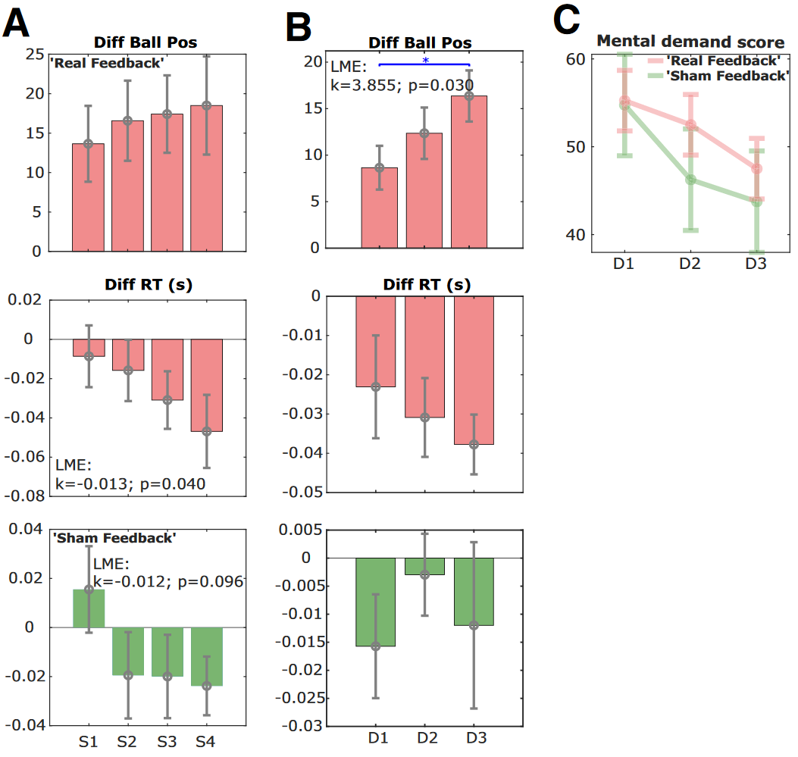
Learning effect of NFT
Notes:
Difference between training and no training conditions:
Progression over Runs of Day 1
Progression over days [due to ceiling effect only for those 75% hemispheres with the worst training effect on the first day]
Top: Ball position
- Progressive increase across sessions
MID:
- RT got faster
BOT:
- no RT improvement in sham feedback group
(C) Self-reported mental demand decreased in both groups
→ Also indicating a learning effect

Slide 22
Discussion

Slide 23
NFB design – time windows
Visual feedback:
Smoother feedback when averaging data over time vs. continuously displaying instantaneous β power (flickering)
Temporal dynamics of the signal of interest:
Long β bursts (over 500 ms) are more closely related to motoric impairment in Parkinson’s disease

Slide 24
Sham control
→ Important to confirm the effect of NFT on observed behavioural alterations compared with other mental strategies
Reasons for the decision to provide pre-recorded resting EEG as feedback in this study:
allows double-blinded study design (no feedback wouldn’t)
ensures similar effort of all participants
match the dynamics in the visual feedback
real physiological EEG signals are very different compared with random signals
Notes:
Determine whether NFT was the primary factor accounting for observed behavioural alterations, or whether other mental strategies were mediating the effects.
Other studies: no feedback, random feedback
[Visual attention to moving objects might induce a reduction in β band activities in the real feedback group, but not the control group.]

Slide 25
Take home’s
The more direct link between movement initiation and β activity is probably with β bursts rather than averaged β power.
Healthy participants can volitionally modulate the incidence of β bursts with NFT.
NFT targeting β bursts may be an effective approach to improve movement initiation.

Slide 26
Research gap
In the future it would be worthwhile investigating whether other β burst-detection methods might be more efficient in real time.

Slide 27
Sources
He, S., Everest-Phillips, C., Clouter, A., Brown, P., & Tan, H. (2020). Neurofeedback-Linked Suppression of Cortical β Bursts Speeds Up Movement Initiation in Healthy Motor Control: A Double-Blind Sham-Controlled Study. Journal of Neuroscience, 40(20), 4021–4032. https://doi.org/10.1523/JNEUROSCI.0208-20.2020
Mehler, D. M. A. (2022). Turning markers into targets – scoping neural circuits for motor neurofeedback training in Parkinson’s disease. Brain-Apparatus Communication: A Journal of Bacomics, 1(1), 1–27. https://doi.org/10.1080/27706710.2022.2061300
Tinkhauser, G., Pogosyan, A., Tan, H., Herz, D. M., Kühn, A. A., & Brown, P. (2017). Beta burst dynamics in Parkinson’s disease OFF and ON dopaminergic medication. Brain : A Journal of Neurology, 140(11), 2968–2981. https://doi.org/10.1093/brain/awx252

Slide 28
Thank you!

Slide 29
Further results
the two hemispheres within the same participant were relatively independent (F.2A)
Investigation whether there were similar changes in other frequency bands:
no interaction between group (real feedback and sham feedback) and condition (training and no training) on the burst characteristics and average power in the β-8 Hz frequency band
significant reduction of average power but not burst characteristics in the training condition compared with the no training condition in the real feedback group, not in the sham feedback group in the β+8Hz frequency band.
no significant difference between the sham feedback and real feedback groups in terms of self-reported mental effort as well as mental strategies used

Slide 30
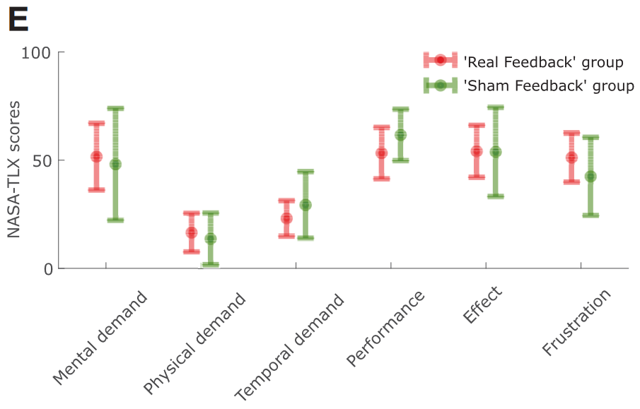
NASA Task Load Index (NASA-TLX)
Notes:
No difference between groups

Slide 31
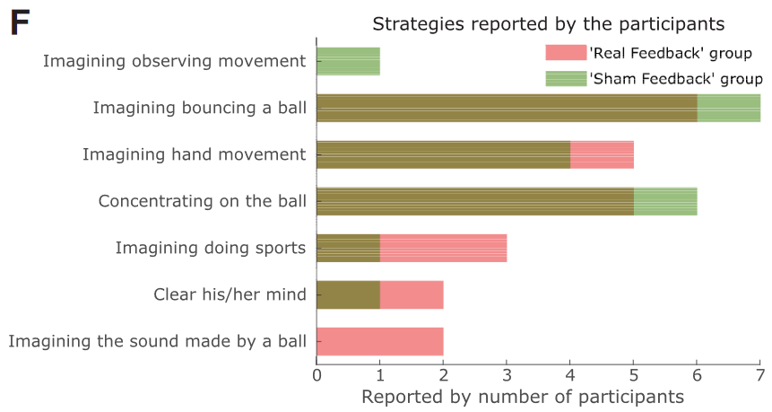
Mental strategies

Slide 32
Causality
“As we purposefully modulated β bursting through neurofeedback we also provide evidence in favour of a causal link between transient β bursts and motor function.” (He et al., 2020)

